Slide 1

NBA Dataset Key Findings

Slide 2
1ST and most important: No Clear ANswer
No clear answer to my research question: “Is an NBA player worth their salary?

Slide 3
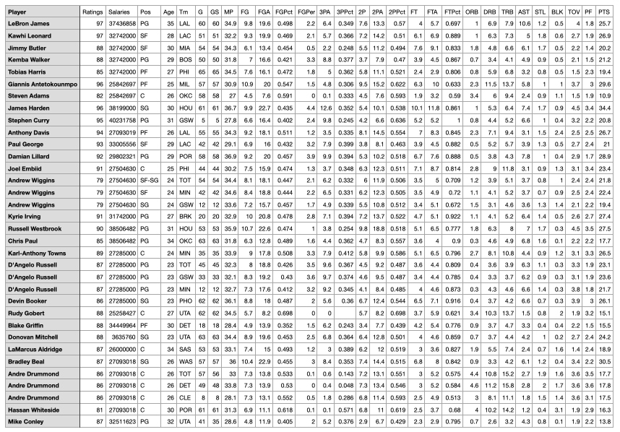
2ND : MORE VARIABLES NEED TO BE INCLUDED

Slide 4
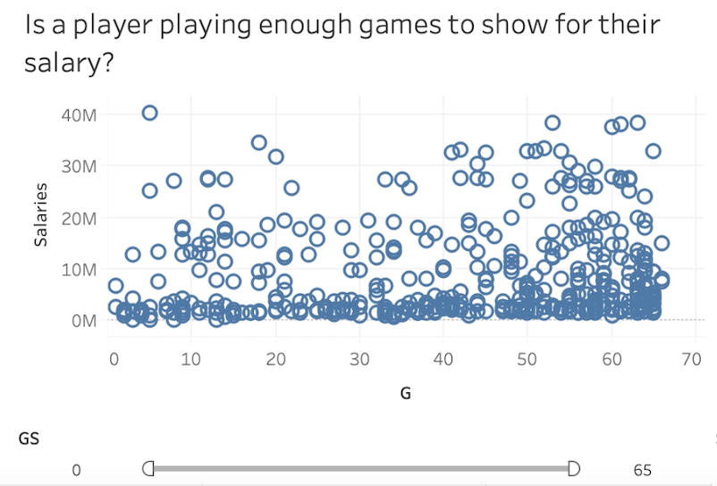
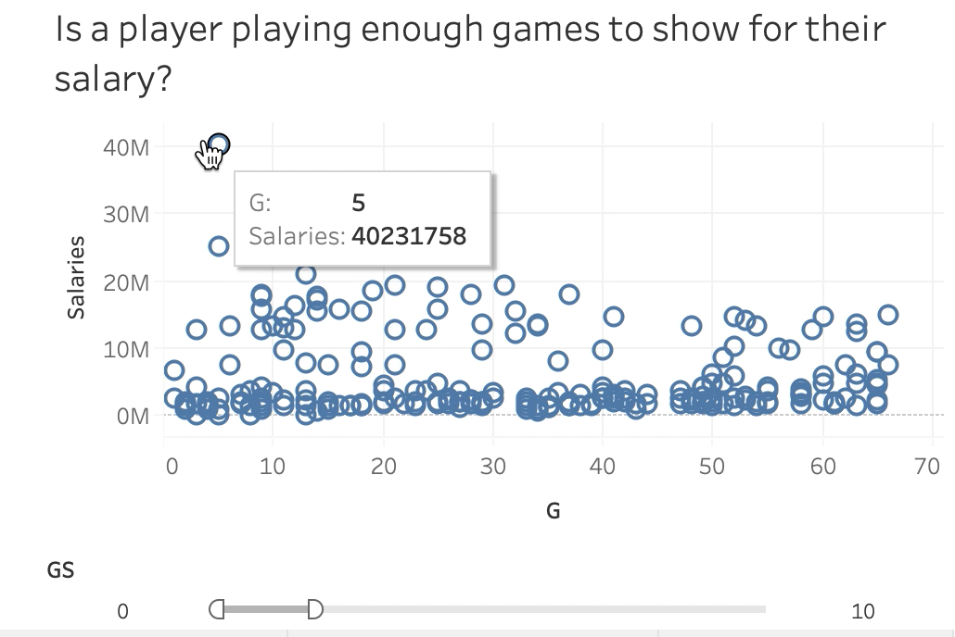
3RD: MY TABLEAU DASHBOARD DISPROVES MY RESEARCH QUESTION

Slide 5

4TH: MORE CONCISE DATA IS NEEDED
Use only one entry for each player that combines stats as shown by TOT

Slide 6
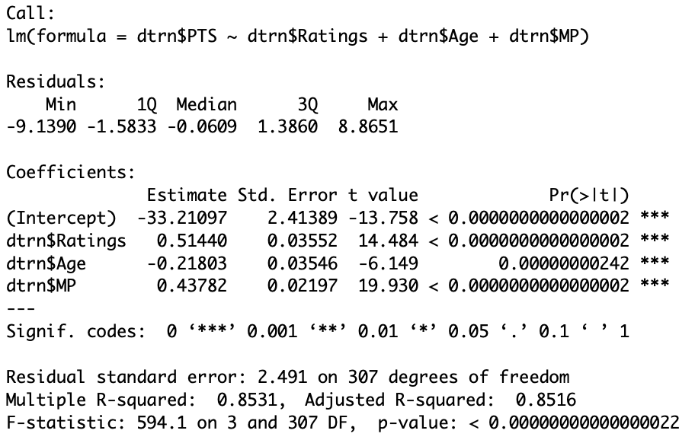
5TH: SURPRISING SIGNIFICANT CONTRIBUTORS

Slide 7

NEXT STEPS?

